Slide 1
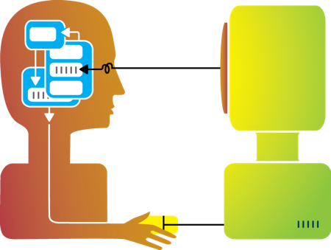
T 467: Human Factors In Information Systems
Jianwei Lai
jlai12@ilstu.edu (Best way to contact me)

Slide 2

Class Info
Reggienet
Syllabus
Schedule will be posted with updates throughout the semester
Weekly lectures
Some announcements will be posted on Reggienet
Some assignments on Reggienet

Slide 3
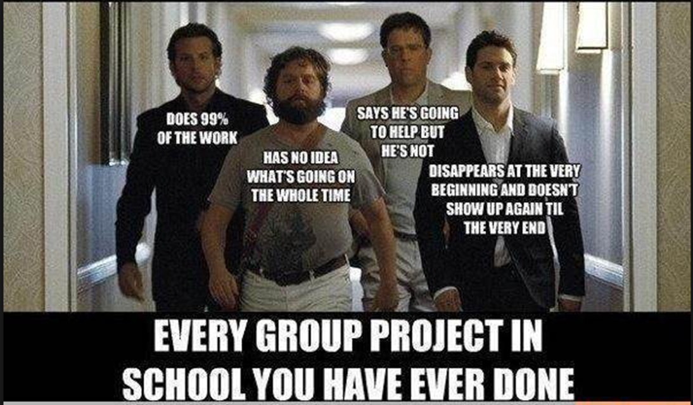
Class organization
You will have both independent work and the opportunity to work in teams

Slide 4
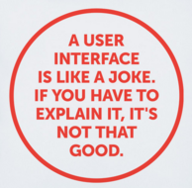
What is a user interface?
A user interface (UI) is the means in which a person controls a software application or hardware device (Solis, 2015)
Input: allowing the users to manipulate a system
Output: allowing the system to indicate the effects of the users
Notes:
The input means and the output means
A good user interface provides a "user-friendly" experience, allowing the user to interact with the software or hardware in a natural and intuitive way.

Slide 5
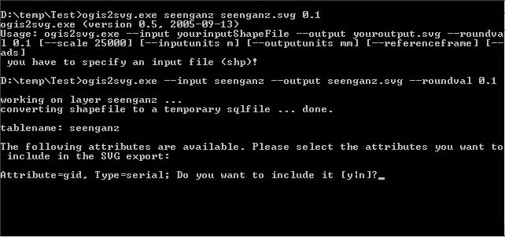
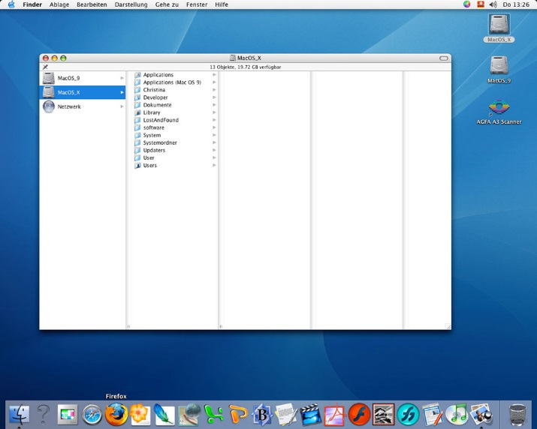
CLI vs. GUI
Command-Line Interface (CLI): The user provides the input by typing a command string with the computer keyboard and the system provides output by printing text on the computer monitor.
Graphical User Interface (GUI): The use of pictures rather than just words to represent the input and output of a program. Input is accepted via devices such as keyboard and mouse.

Slide 6
Why UI is important?
To users, the interface is the system.
Users often judge a system by its interface rather than its functionality.
A good user interface provides a "user-friendly" experience.
Poor user interface design is the reason why many software systems are never used.
A poorly designed interface can cause a user to make catastrophic errors.
Good Design
Good User Experience
More Users

Slide 7
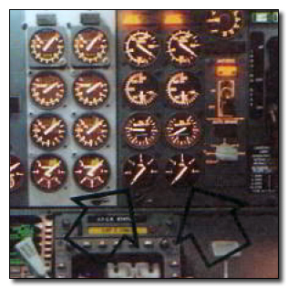
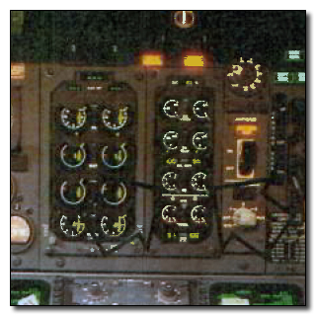
A Boeing 737 crashed because of a new digital dial (England, 1989)
Old model of dial
New digital dial
Notes:
The problems started when the jet began vibrating, indicating that one of its two engines was malfunctioning. Unfortunately, the pilots got the impression that the good engine was at fault and turned it off.
"They're just circles, they don't have needles pointing at anything,"

Slide 8
Let’s go thru the syllabus & Schedule!

Slide 9

I’m stopping here to be nice on the first day

